Slide 1


Rakibul Hasan Rajib | 1921834
Md. Mahmud Hassan Rabby | 1731609
Misbah Ahmed | 1510998
Tamima Sigma | 1630436
Hasan Ahmed | 1610266
Udipta Mazumder | 1710138
Md Rakib Hossain | 1731400
Database Management System
Section : 1
Group : 1

Slide 2




As–Is System
Rich Picture(As-is)
Six Element Analysis
Business Process Diagram
Problem Analysis

Slide 3
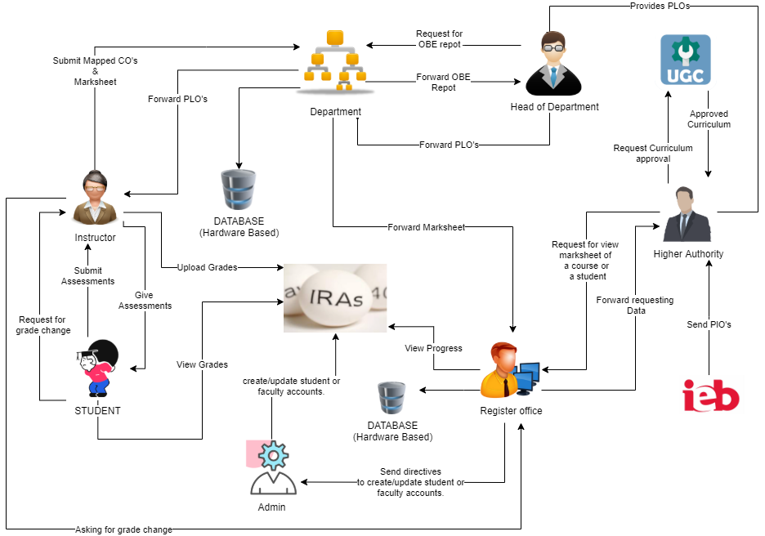
Rich Picture (AS-IS)

Slide 4
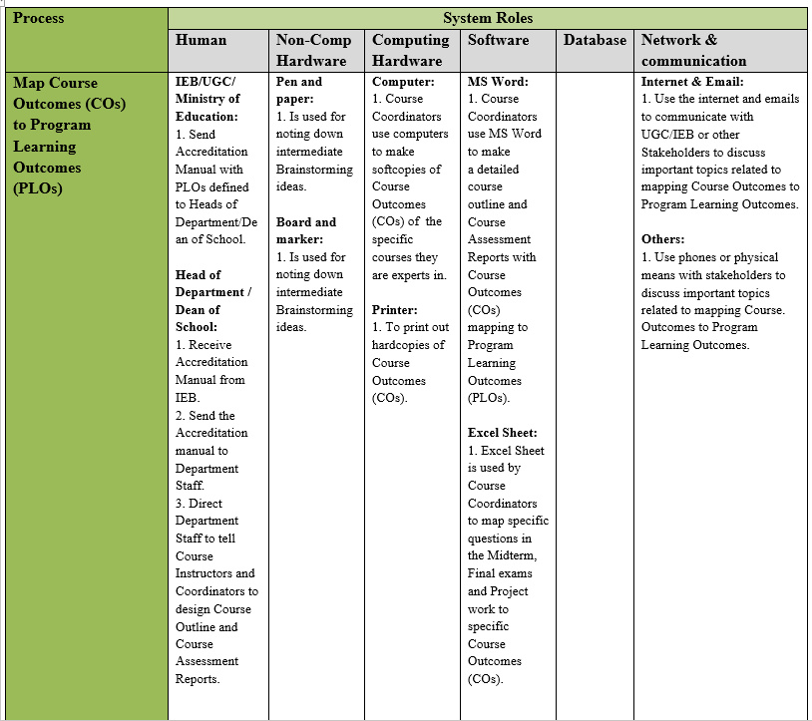
Six Element Analysis (As-is)

Slide 5
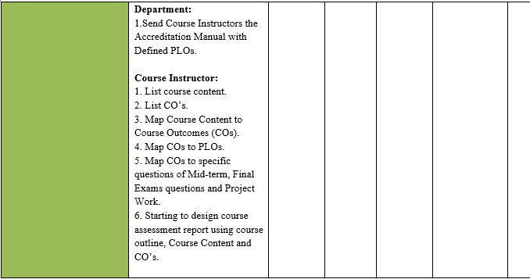

Slide 6
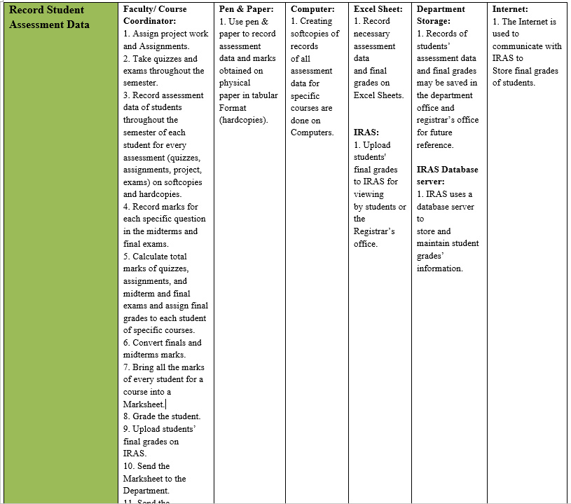

Slide 7
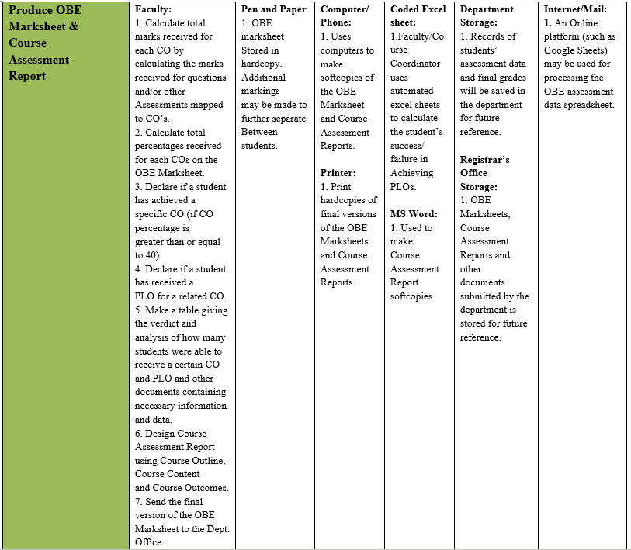

Slide 8


Slide 9
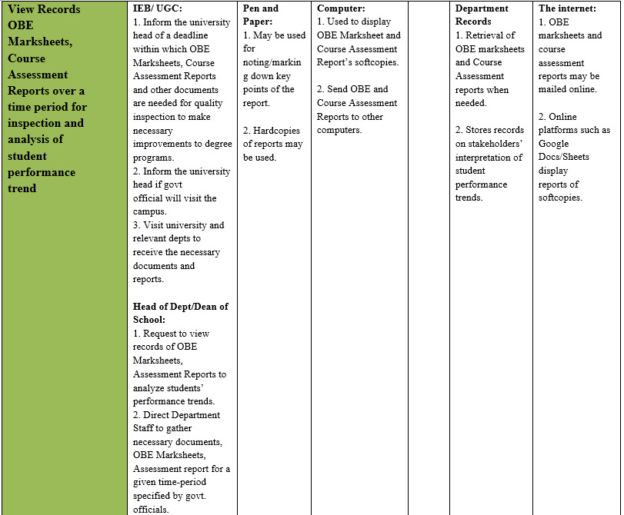

Slide 10
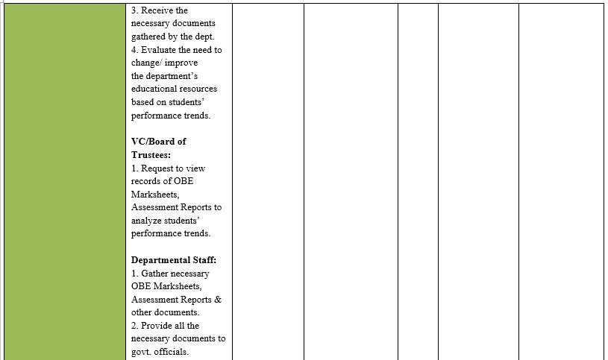

Slide 11
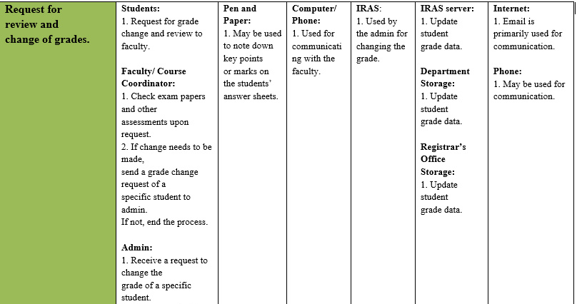

Slide 12

Business Process Diagram (As-Is)
Evaluate and update CO

Slide 13
Set question paper and conclude exam

Slide 14
Problem Analysis
Problems:
Time Consuming
Every Stakeholder in each process needs to play a role to get to a solution
Complicated
Interdependent
Higher management collect PLO

Slide 15
Mapping of CO from PLO

Slide 16
UGC approves curriculum

Slide 17
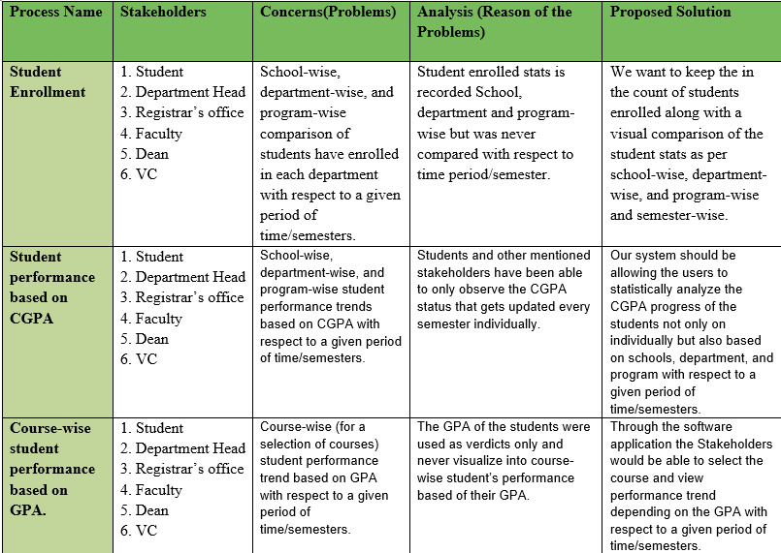
Problem Analysis

Slide 18
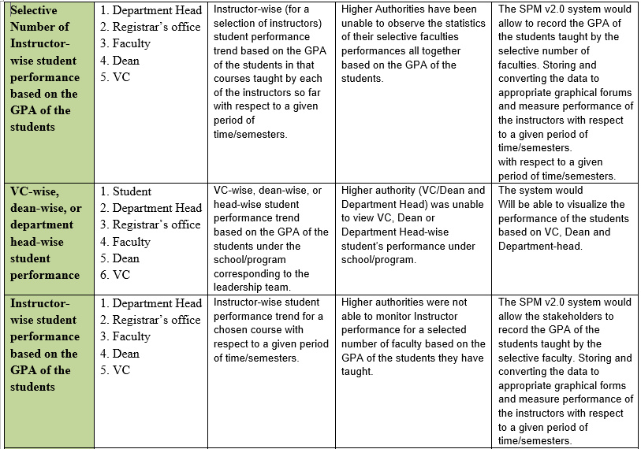

Slide 19
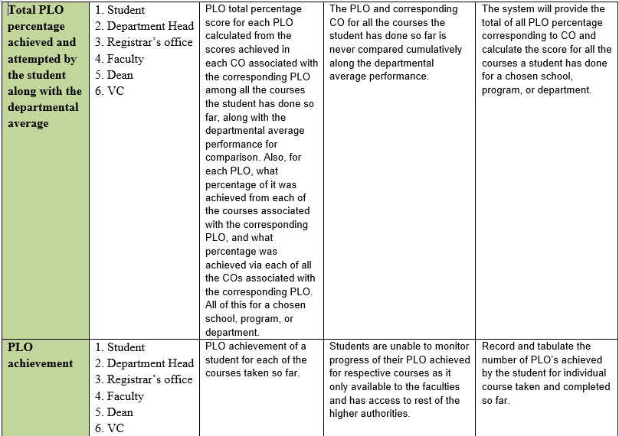

Slide 20
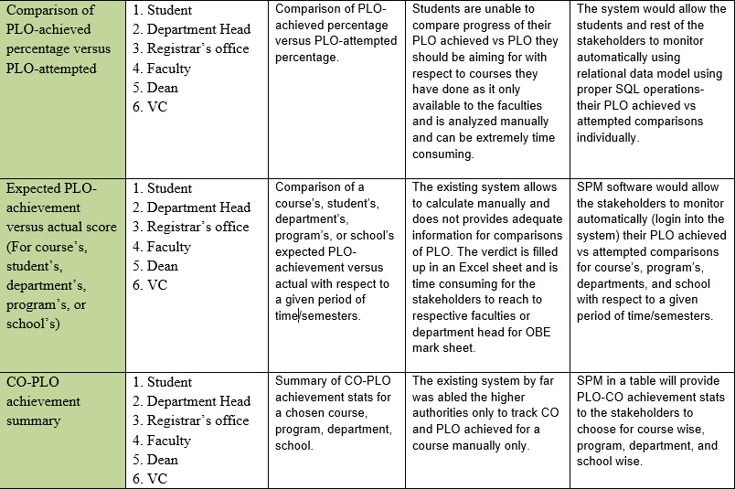

Slide 21

Proposed System
Rich Picture(As-is)
Six-Element Analysis
Business Process Diagram
Solution

Slide 22
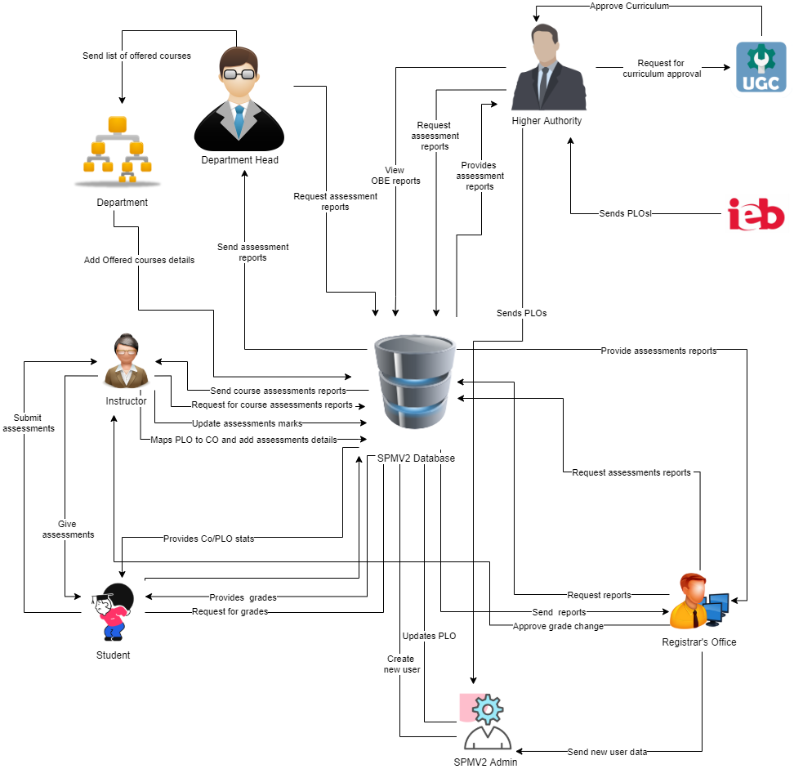
Rich Picture (To-be)

Slide 23
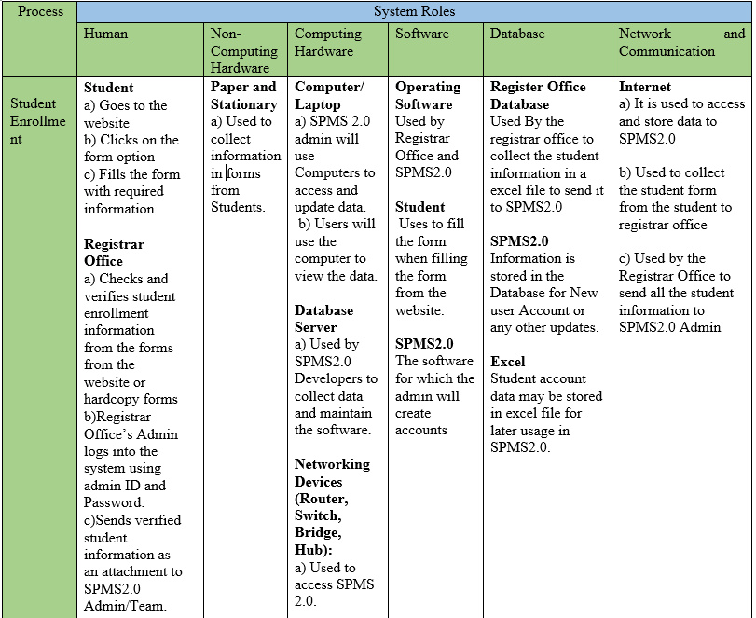
Six Element Analysis
(To-be)

Slide 24
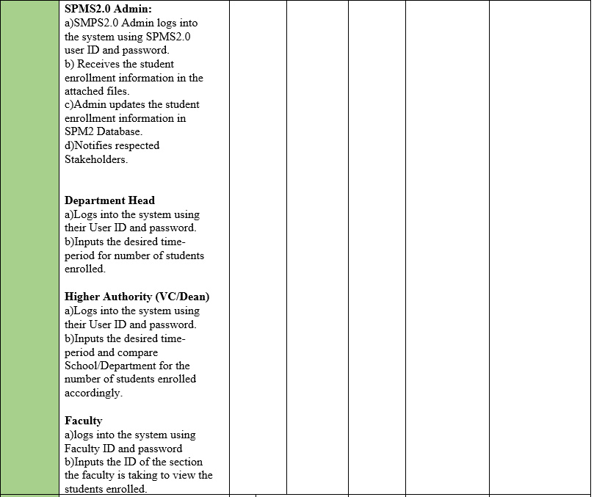

Slide 25
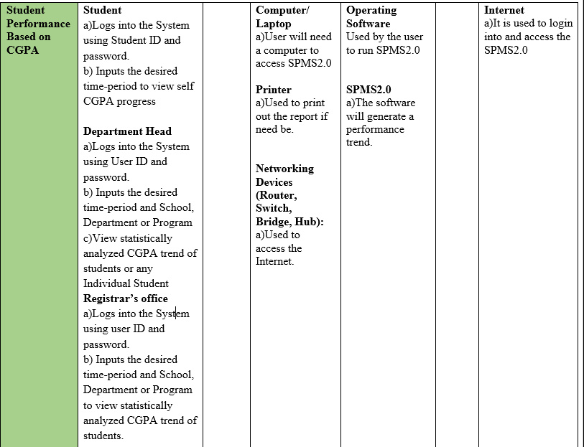

Slide 26
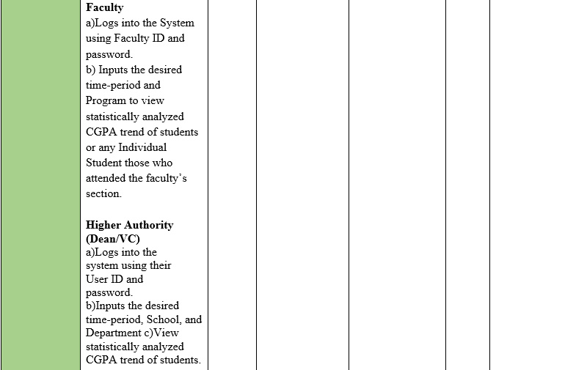

Slide 27
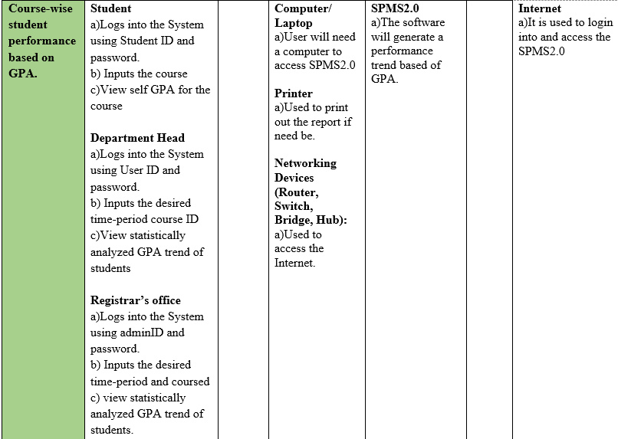

Slide 28
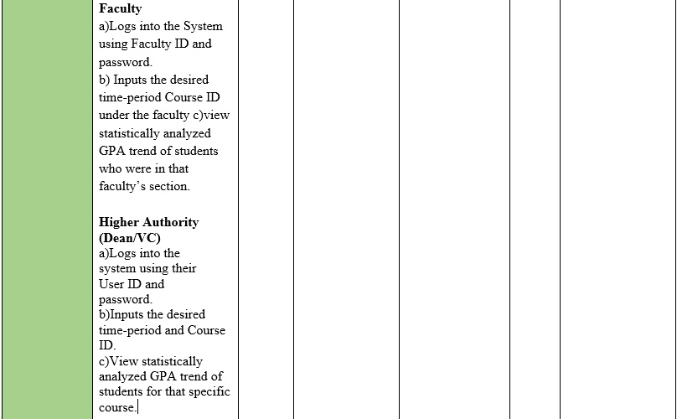

Slide 29
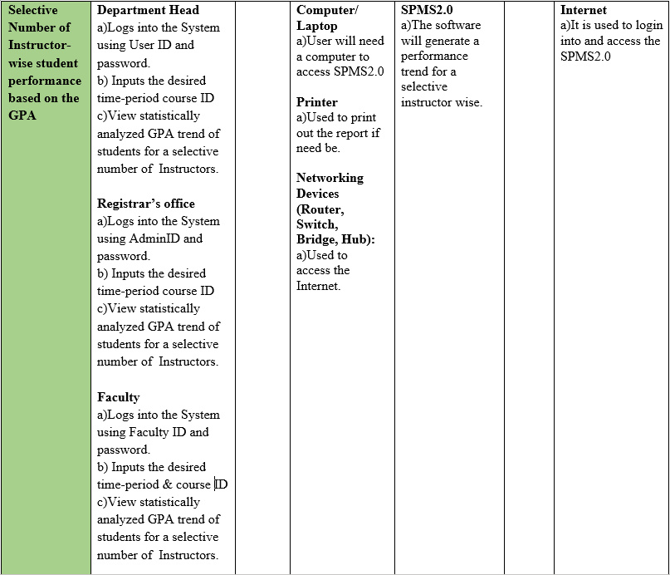

Slide 30
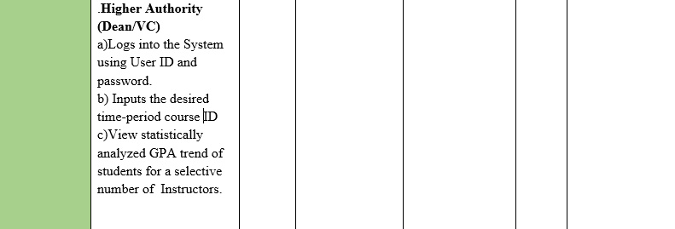

Slide 31
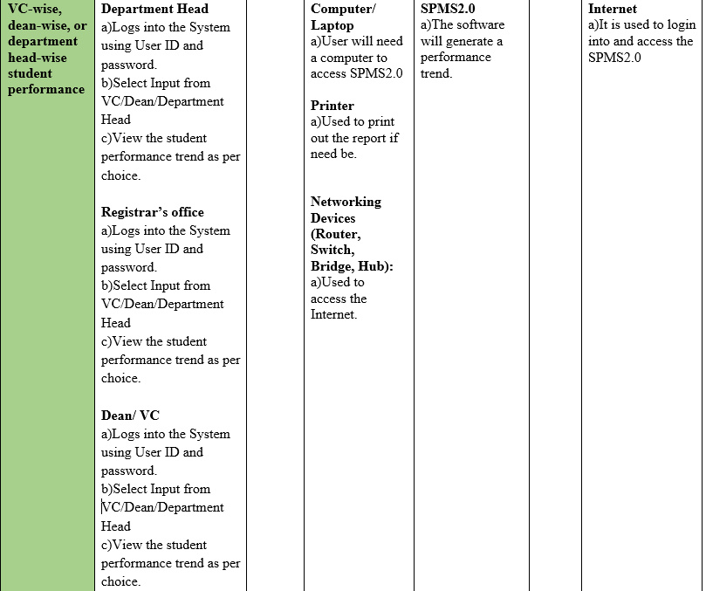

Slide 32
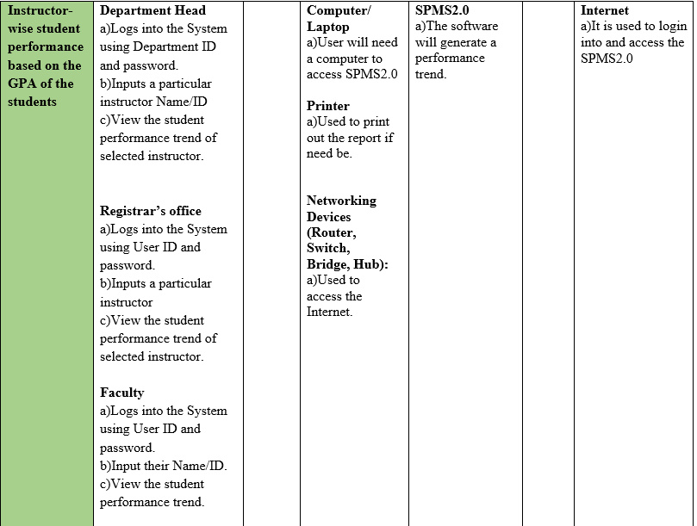

Slide 33
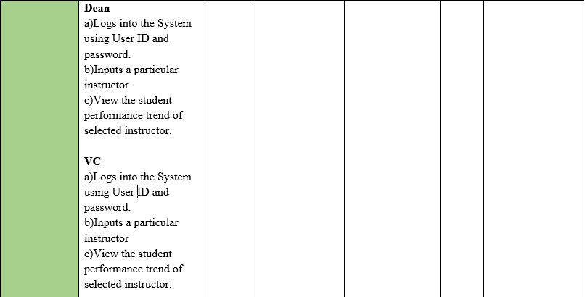

Slide 34
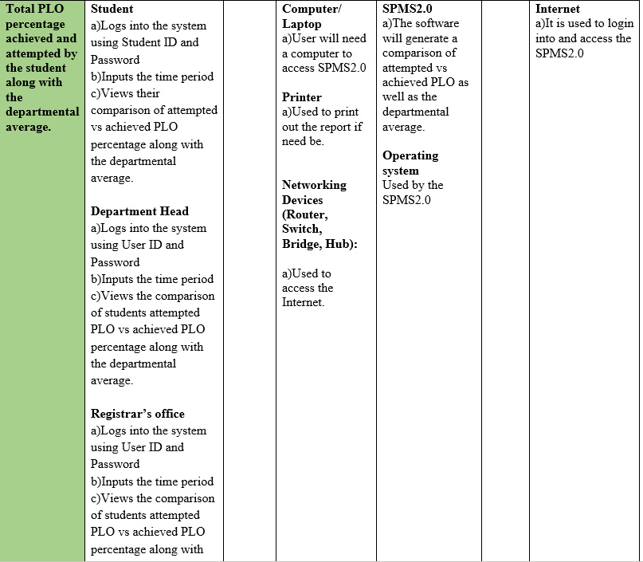

Slide 35
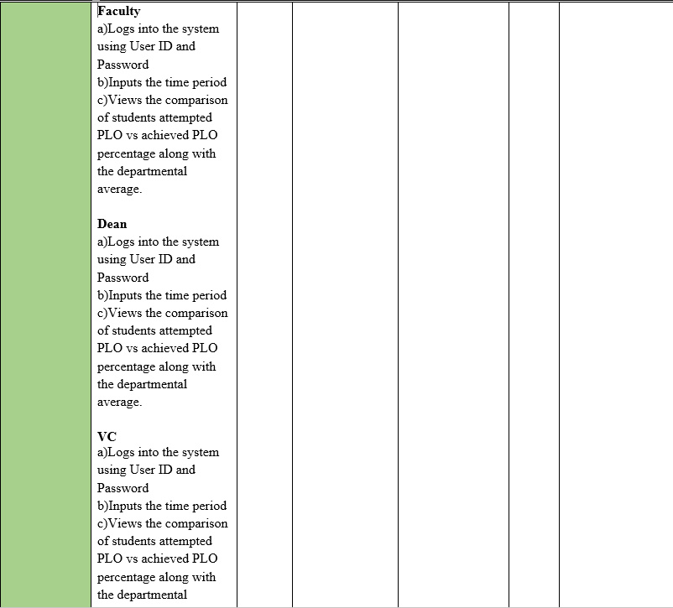

Slide 36
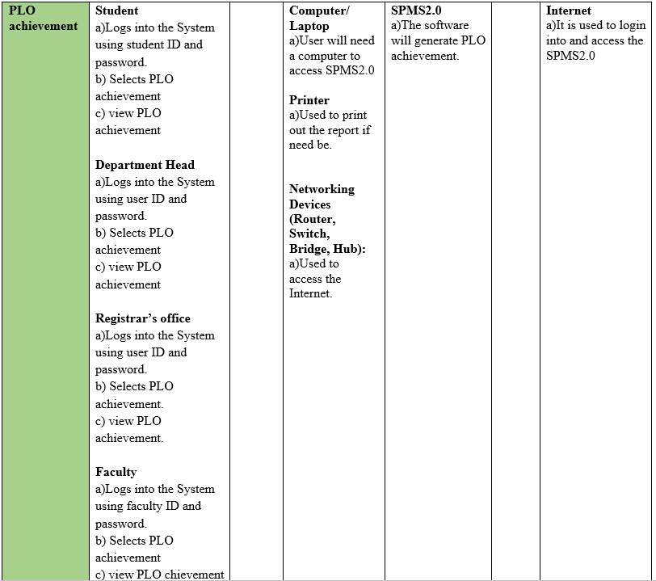

Slide 37
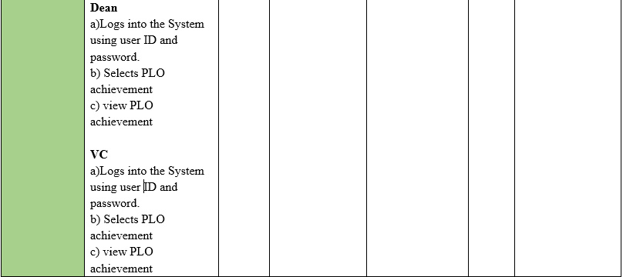

Slide 38
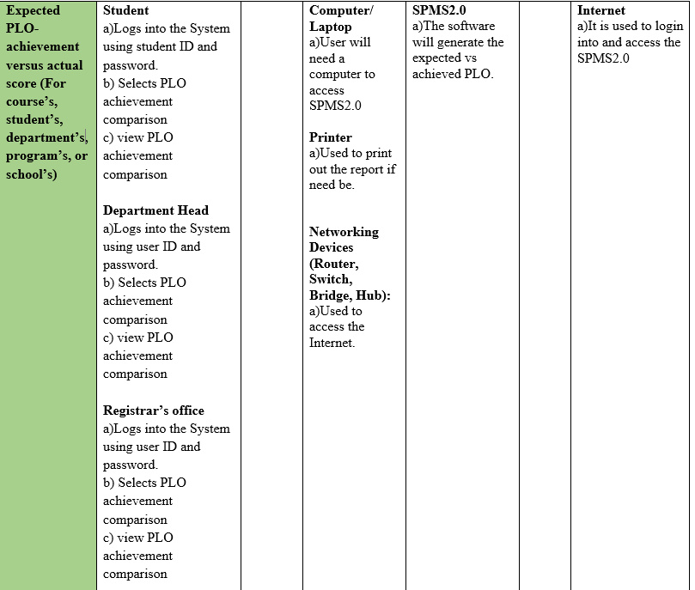

Slide 39
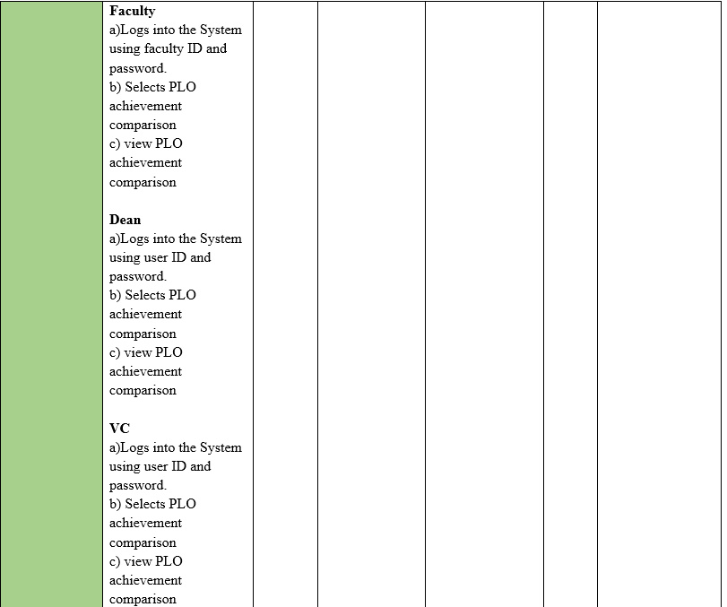

Slide 40
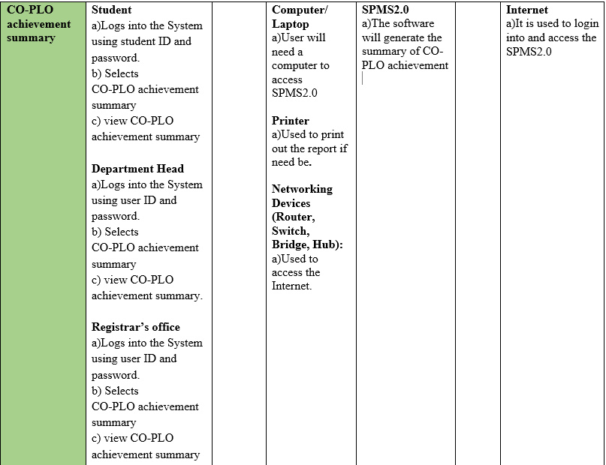

Slide 41
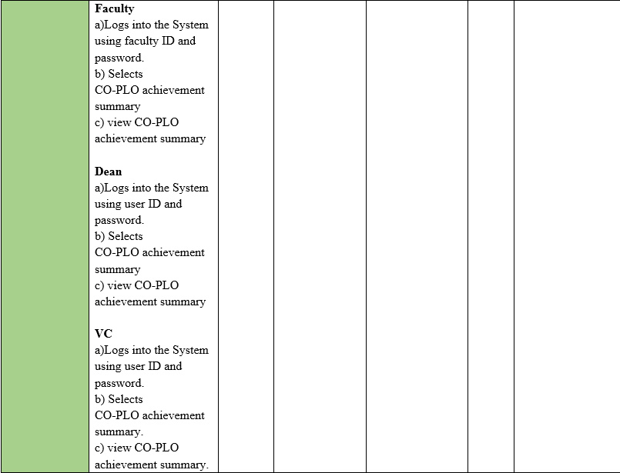

Slide 42
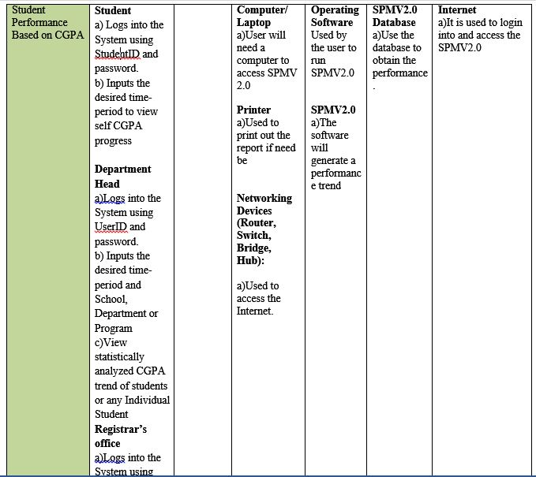
Student Performance based on CGPA

Slide 43
Selective Number of Instructor-wise Performance based on GPA

Slide 44
Course-wise Student Performance based on CGPA

Slide 45
Total PLO Percentage achieved and attempted by the Student along with the departmental average

Slide 46
Instructor wise Student Performance based of the GPA of the Students

Slide 47
PLO Achievement

Slide 48
Comparison of PLO Achieved Percentage Vs Attempted

Slide 49
Expected PLO Achieved Vs Actual Score

Slide 50
CO-PLO Summary

Slide 51
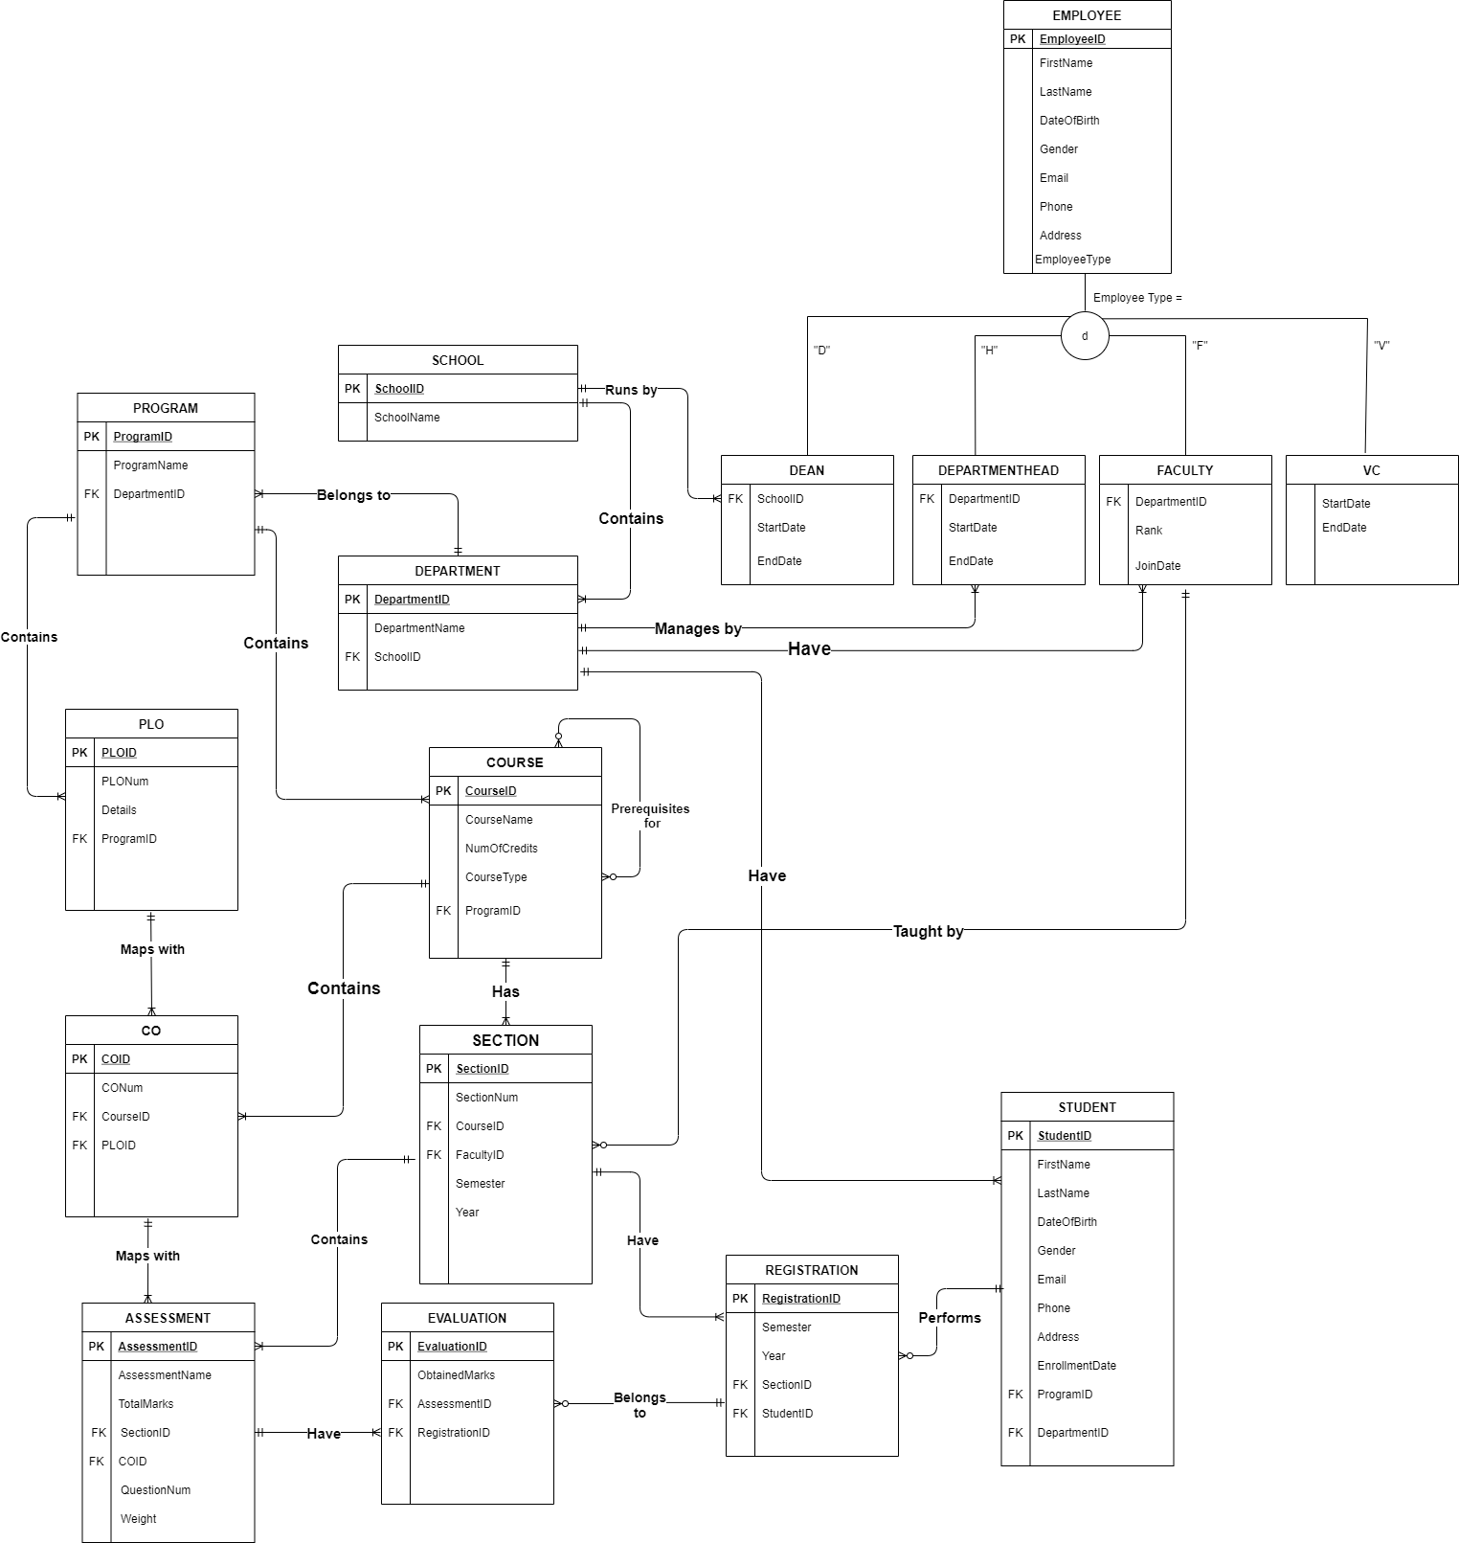
ERD

Slide 52
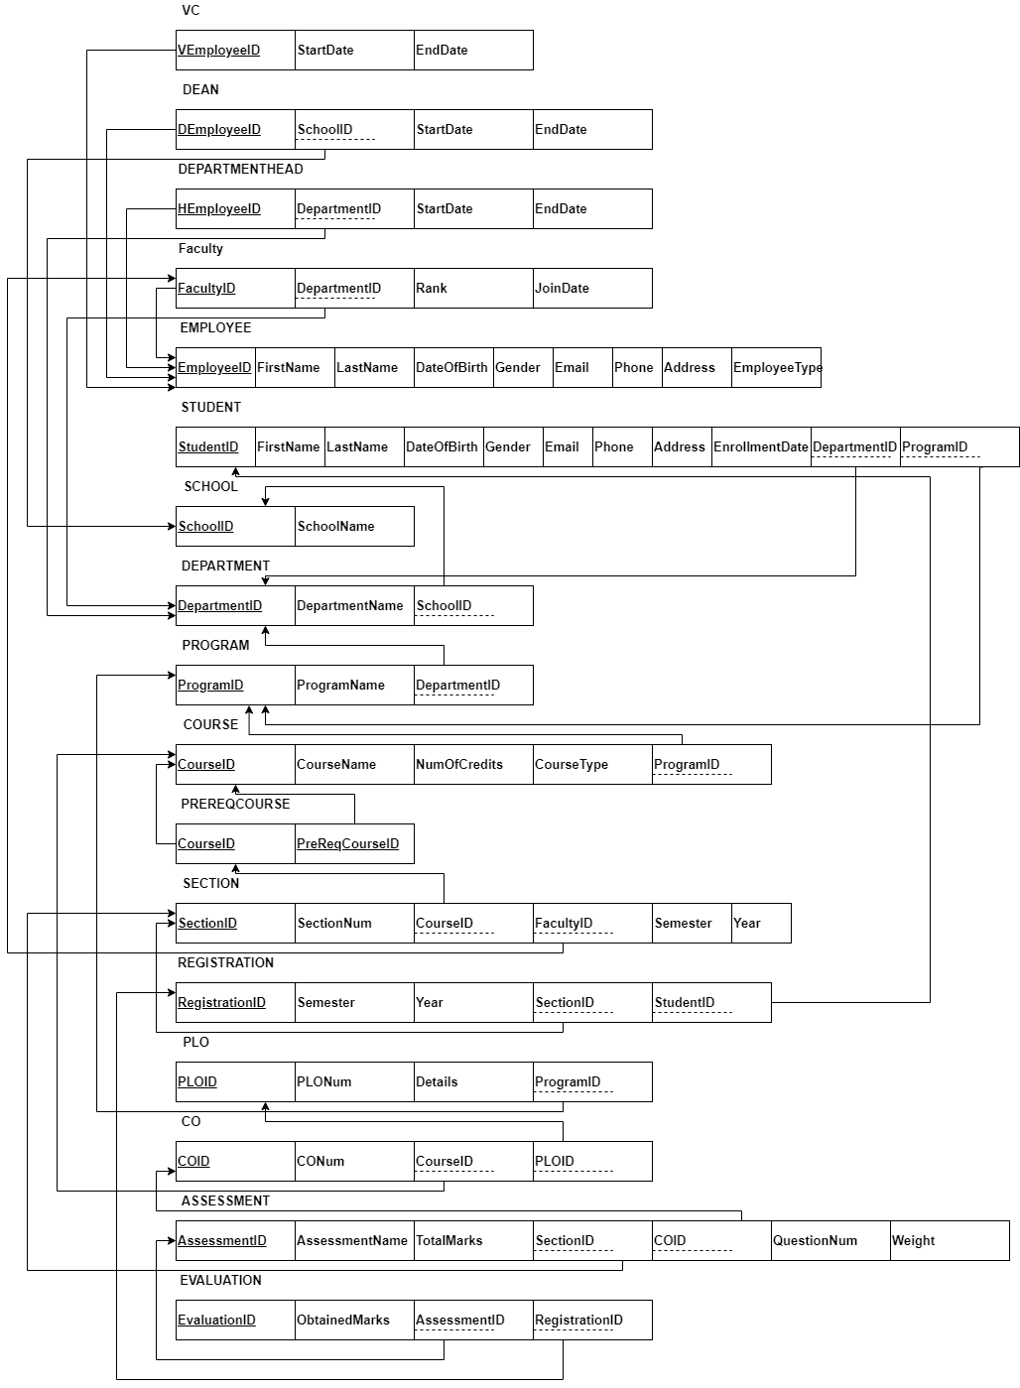
ERD to Relational
Schema

Slide 53
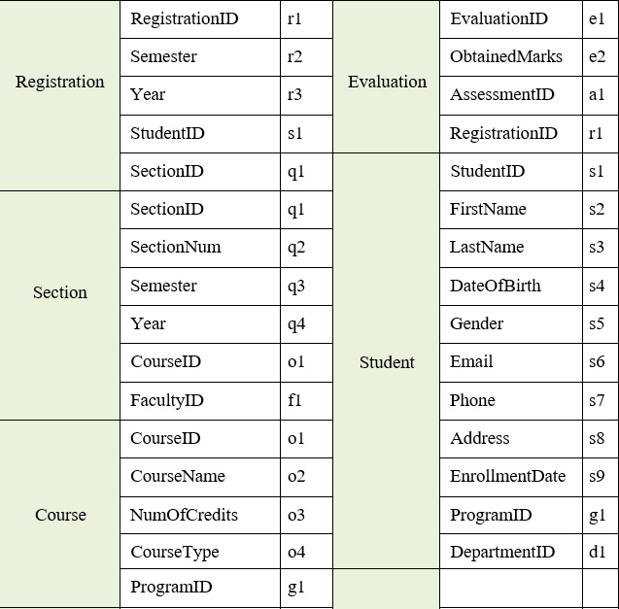
NORMALIZATION

Slide 54
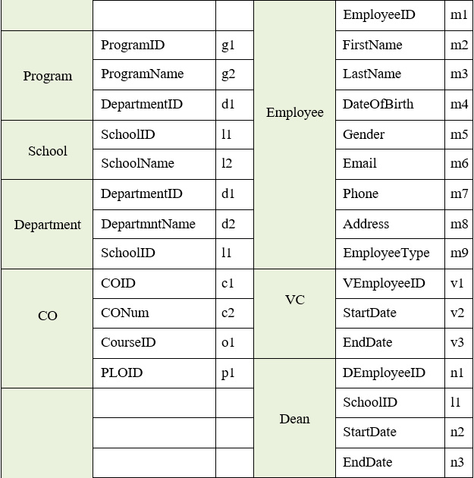

Slide 55
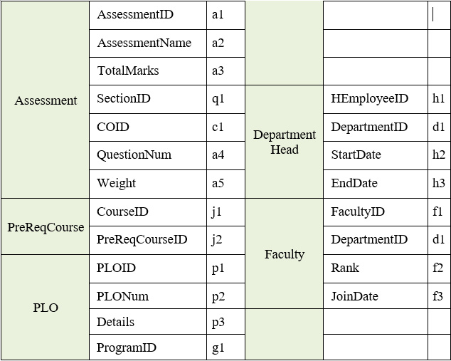

Slide 56
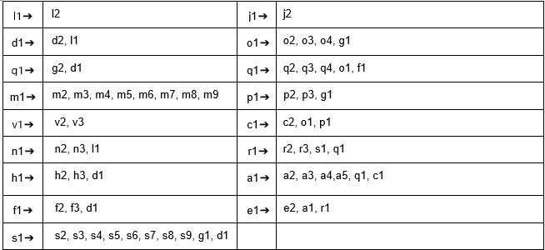

Slide 57
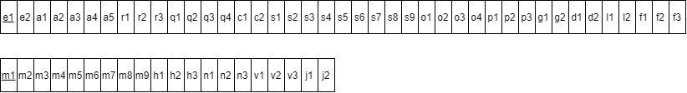
1 NF

Slide 58
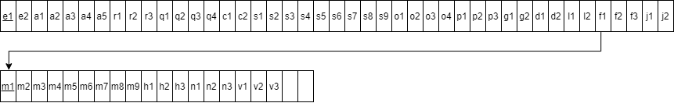
2 NF

Slide 59
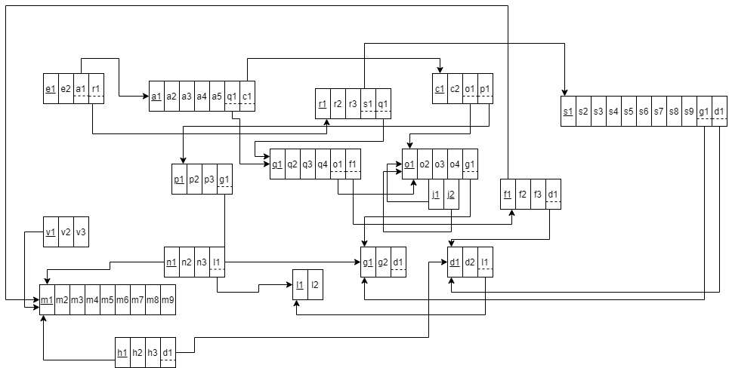
3 NF

Slide 61

Implementation

Slide 62
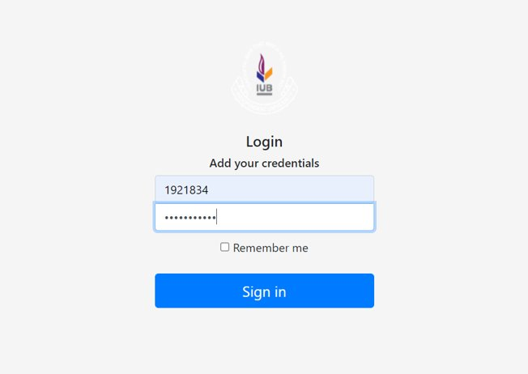
Log In Dashboard of SPMV 2
Front End: HTML, Java Script,
Bootstrap and CSS
Local hosting: spmapp​
Backend: Django

Slide 63
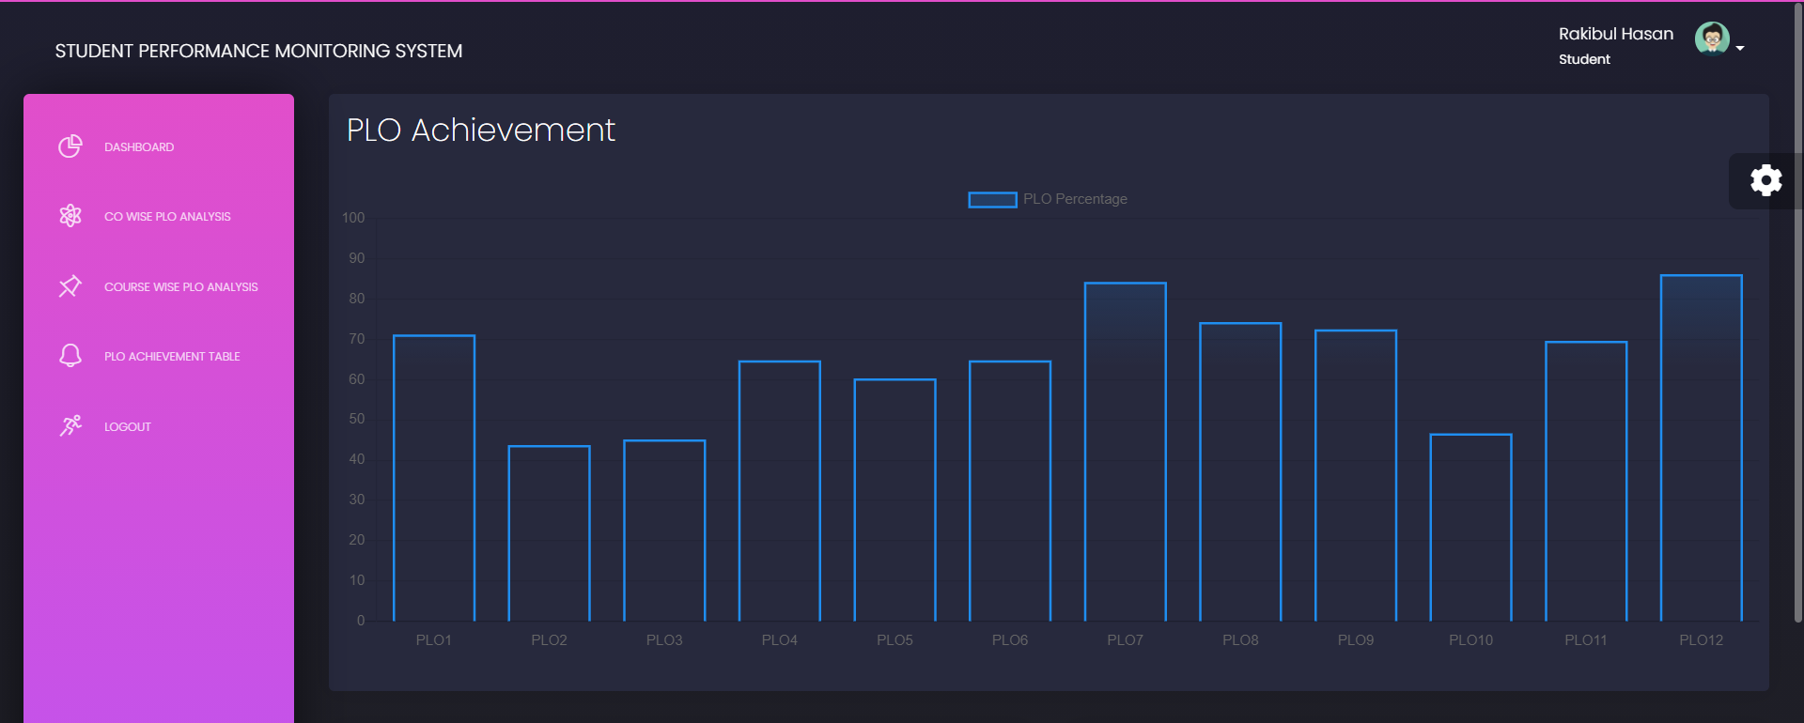

Slide 64
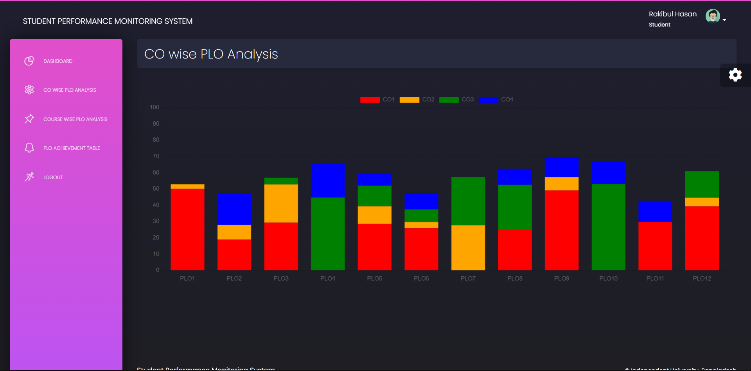

Slide 65
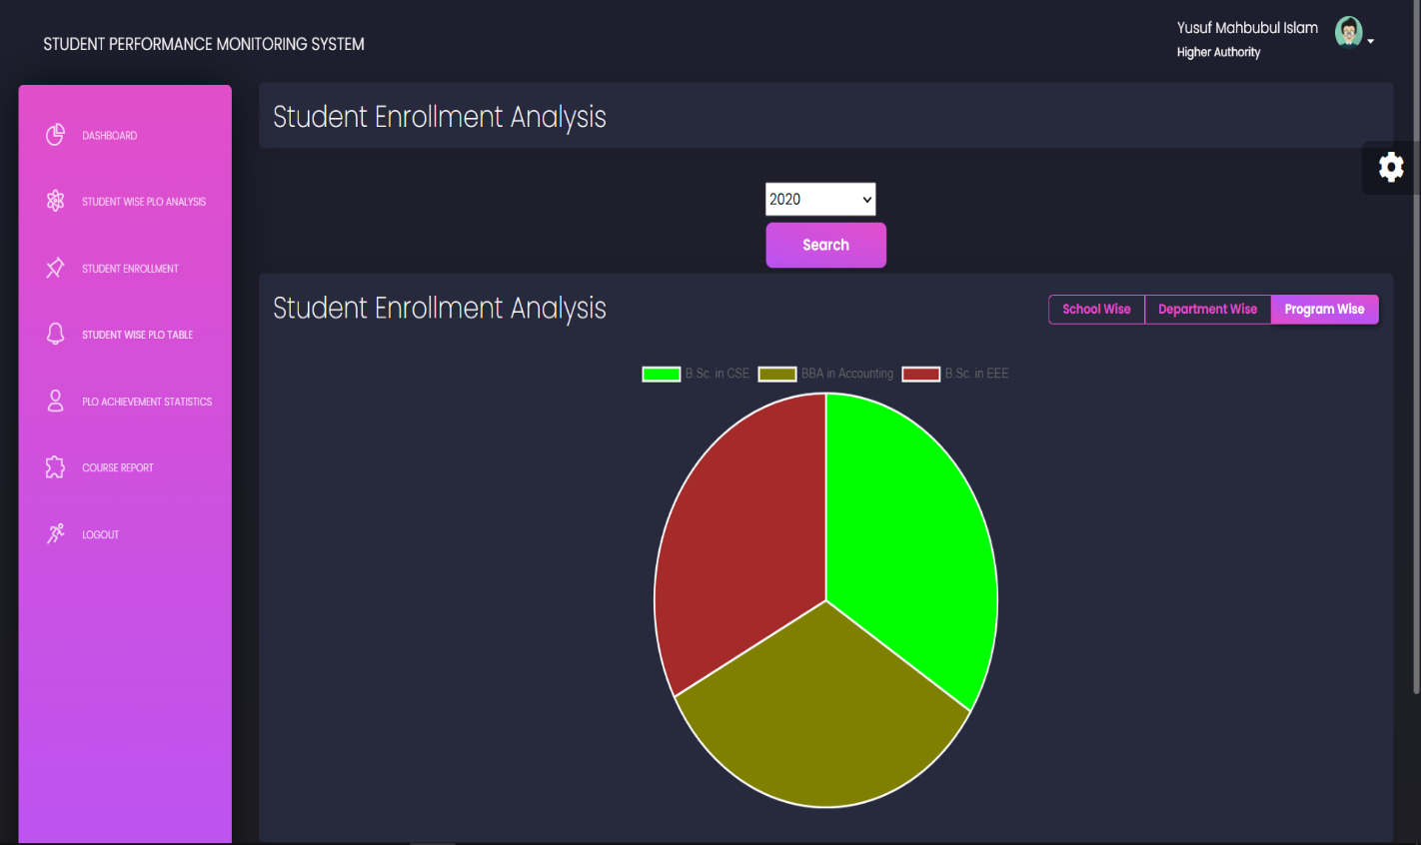

Slide 66
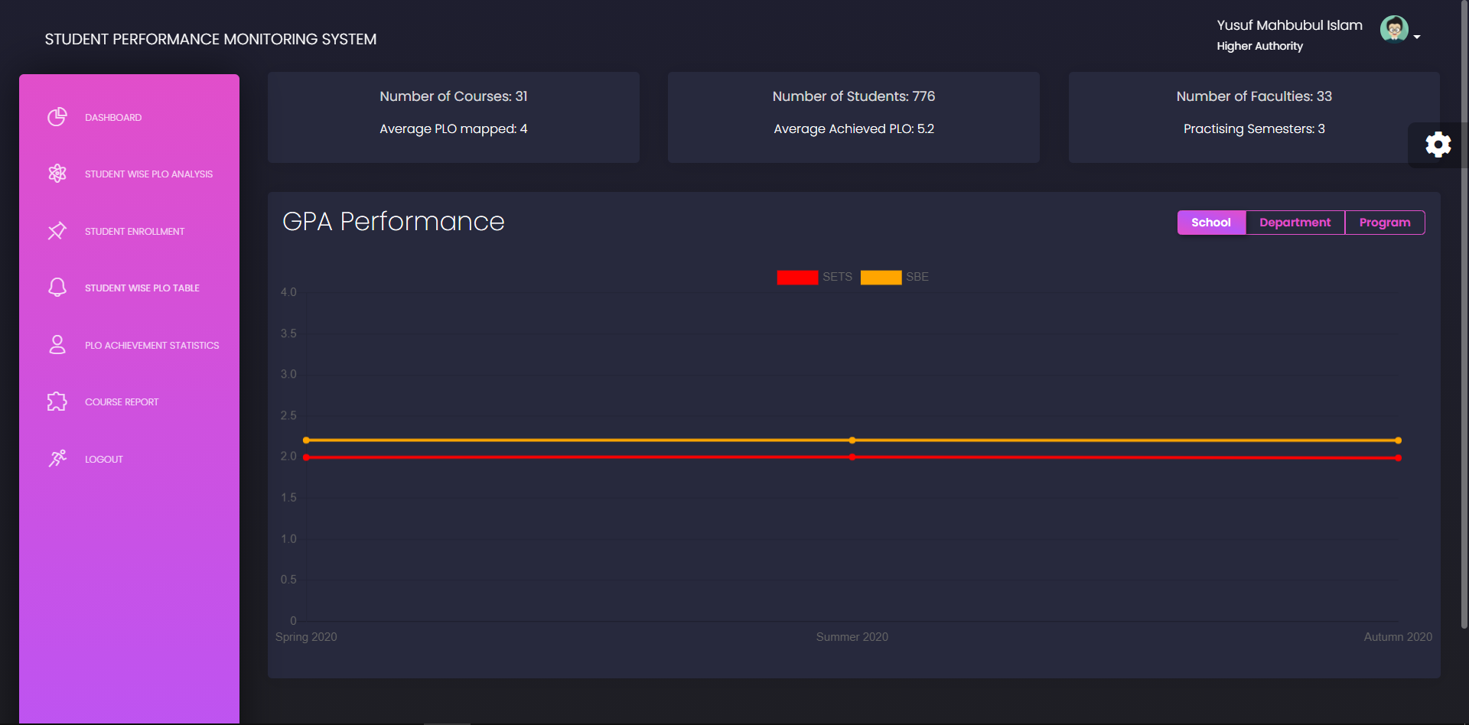

Slide 67
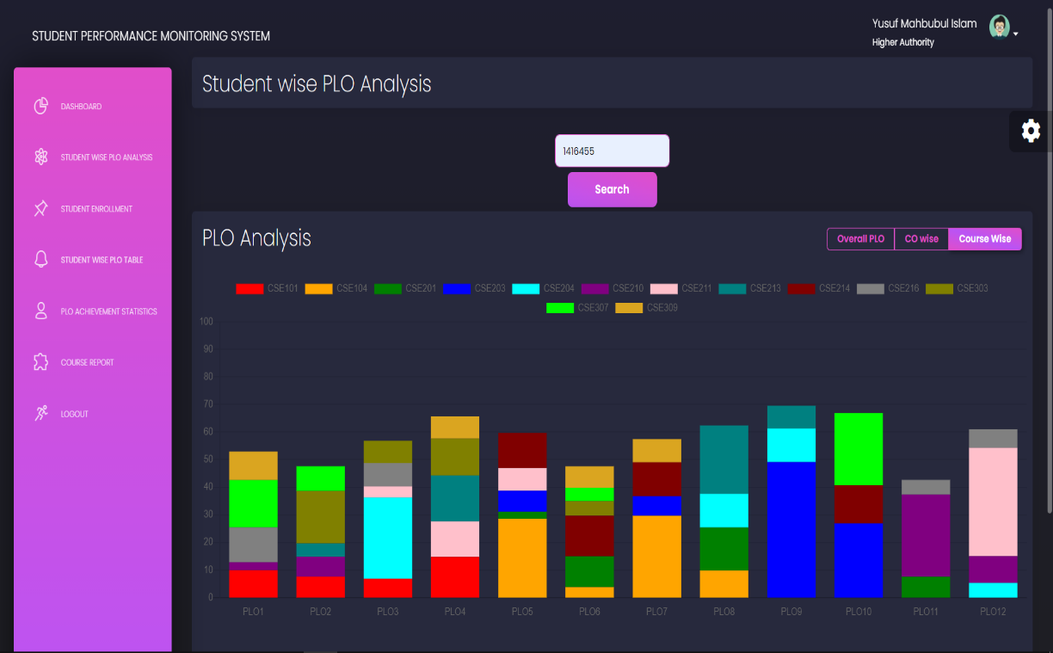

Slide 68
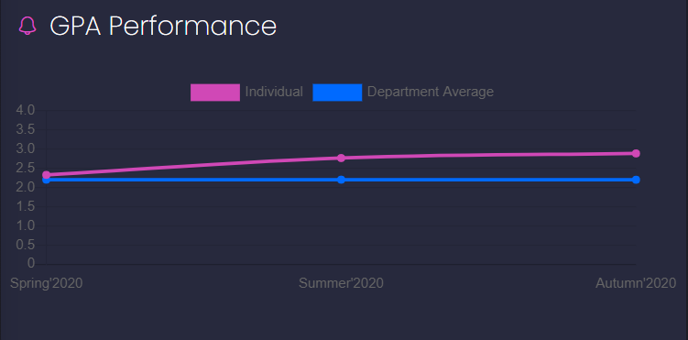

Slide 69
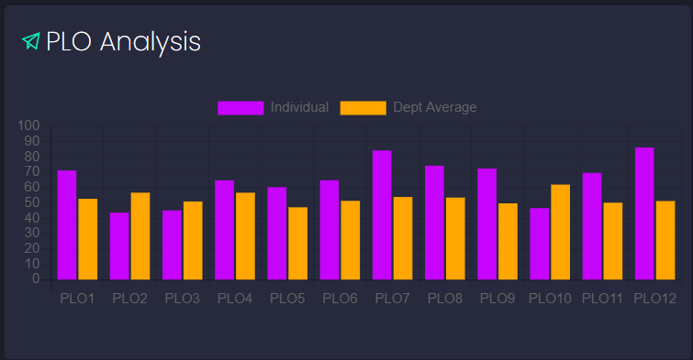

Slide 70
Thank you

